Slide 1
July 2020 Working group
Health Promotion and Health Education

Slide 2
Defining Health Education and Health Promotion
Health Education – Supporting a client in understanding health conditions, treatments, and preventative measures in a way which leads to the client being able to make informed healthcare decisions
Health Promotion – teaching a client about health conditions, treatments, and preventions in a way that empowers a client to make lifestyle, social, or environmental changes that will improve their overall health and wellness

Slide 3
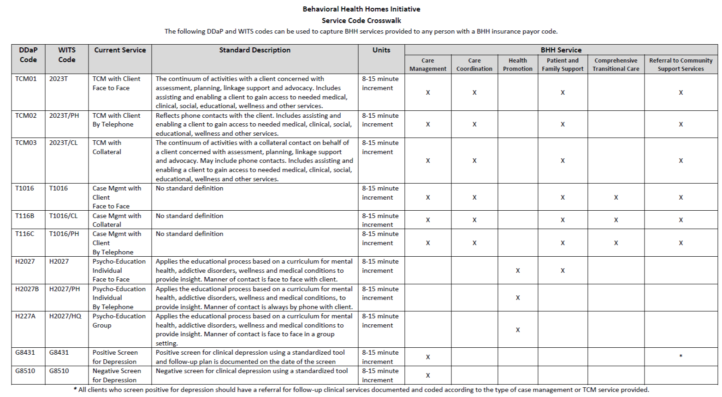

Slide 4
Health Promotion as a BHH Core Service
Services that encourage and support healthy living concepts to motivate individuals to adopt healthy behaviors and promote self-management of health and wellness. Specific activities include:
· Informing and educating to promote health
· Intervening to promote healthy lifestyles
# of Psycho-Education Hours by Code Description (FY19)
Agency Type | Psycho-Education Group | Psycho-Education Individual By Telephone | Psycho-Education Individual Face to Face | Grand Total
Private Nonprofit | 12451 | 858 | 9565 | 22874
State-Operated Facility | 6941 | 690 | 5795 | 13426
Grand Total | 19392 | 1548 | 15360 | 36300

Slide 5
Differentiating between Health Education and Health Promotion
 | Health Education | Health Promotion
Teaches client health information
Requires curriculum/presentation
Billable services are TCM and CM
Billable service is Psycho-education
Empowers client to make lifestyle changes
Allows client to make informed healthcare decisions

Slide 6
Psycho Education and Health Promotion
Psycho Education is the billable service. Health Promotion is the BHH Core Service.
Health Promotion Offered to an individual (Psycho Education face-to-face) (Psycho Education over-the-phone) | Health Promotion offered to a group (Psycho Education Group)
Overview of health condition affecting the client Discussion includes lifestyle/social barriers causing client to experience poor health and wellness Client receives knowledge/skills that will empower them to make better choices | Overview of health condition prevalent among a population Discussion includes how lifestyle/social choices can have a negative impact on health and wellness Participants receive knowledge/skills that will empower them to make better choices

Slide 7
How to bill for Health Education
Health Education is not a BHH Core Service
There are ways to capture it using case management billable service codes
Case Management Service | Example
Planning | Helping a client prepare for a follow-up medical appointment Discussing who a client should see to receive treatment Reviewing questions to ask during a medical appointment
Supporting | Giving client an informational sheet on a medical condition Answering a client’s question on a medical diagnosis Providing a client with online resources
Advocating | Speaking with a community provider to discuss a client’s preferred treatment

Slide 8
Monthly Health Observances
Opportunity to provide both Health Promotion (Psycho-Education) and Health Education (Case Management) services
EXAMPLE: Diabetes Month
Health Education
Handing out brochures, pamphlets, and flyers with information on diabetes
Confirming proper insulin usage/frequency with diabetic clients
Discussing medications that may impact A1c with primary doctor
Health Promotion – using a curriculum/presentation to::
Stress the importance of a healthy diet to manage diabetes and review grocery budget with client
Provide clients with changes they can make to prevent low blood sugar/hospitalization related to their diabetes
Work with pre-diabetic clients to prevent a diabetes diagnosis through lifestyle changes

Slide 9
Tableau Reports: CHN Monthly Gaps in Care
Opportunity to provide both Health Promotion (Psycho-Education) and Health Education (Case Management) services
EXAMPLE: Adults Diabetes Screenings
Health Education
Calling client to remind them they are due for a screening
Reviewing with the client what to expect at the screening appointment
Health Promotion – using a curriculum/presentation to:
Stress the importance of diabetes screening in a way that empowers client to schedule and keep future appointments
Learn why client has not been able to get screened and develop a plan of action, alongside the client, to overcome social/lifestyle barriers

Slide 10
Tableau Reports: CHN Monthly Gaps in Care
Opportunity to provide Health Education (Targeted Case Management and Case Management) services
EXAMPLE: Medications that May Raise A1c
Health Education
TCM
Advocating on client’s behalf (meeting with PCP to discuss medications that may raise A1c; discussing alternatives)
Monitoring client (discussing medication usage and reviewing A1c levels)
Case Management
Supporting client (helping client understand how medications can impact A1c)

Slide 11
Tableau Reports: CHN Monthly Gaps in Care
Opportunity to provide Health Education (Targeted Case Management and Case Management) services
EXAMPLE: Breast Cancer Screening
Health Education
TCM
Coordinating a plan for the client to get screened
Linking client to community providers
Monitoring that client receives screening
Case Management
Supporting client before and after appointment
Educating client on what to expect, questions to ask before appointment
Following-Up with client after appointment

Slide 12
Tableau Reports: CHN Monthly Gaps in Care
Opportunity to provide Health Promotion Service (Psycho-Education)
EXAMPLE: Last Wellness Check Reports
Child Wellness (<18)
Status | 2018 | 2019 | 2020 | No Wellness Check on File | Grand Total
Due | 12 | 9 |  | 46 | 67
Not Due |  | 27 | 12 |  | 39
Grand Total | 12 | 36 | 12 | 46 | 106
Adult Wellness (21-49)
Status | 2009 | 2010 | 2011 | 2012 | 2013 | 2014 | 2015 | 2016 | 2017 | 2018 | 2019 | 2020 | No Wellness Check on File | Grand Total
Due | 1 | 12 | 15 | 16 | 31 | 38 | 70 | 99 | 140 | 268 | 231 |  | 181 | 1102
Not Due |  |  |  |  |  |  |  |  |  |  | 328 | 223 |  | 551
Grand Total | 1 | 12 | 15 | 16 | 31 | 38 | 70 | 99 | 140 | 268 | 559 | 223 | 181 | 1653
Adult Wellness (50-64)
Status | 2009 | 2010 | 2011 | 2012 | 2013 | 2014 | 2015 | 2016 | 2017 | 2018 | 2019 | 2020 | Not Wellness Check on File | Grand Total
Due | 2 | 14 | 19 | 16 | 27 | 40 | 66 | 81 | 116 | 181 | 162 |  | 151 | 875
Not Due |  |  |  |  |  |  |  |  |  |  | 275 | 156 |  | 431
Grand Total | 2 | 14 | 19 | 16 | 27 | 40 | 66 | 81 | 116 | 181 | 437 | 156 | 151 | 1306

Slide 13
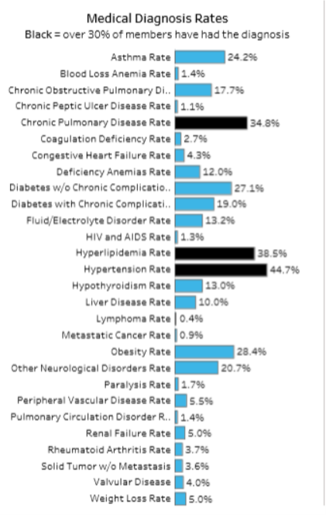
Tableau Reports: BHH Pop Health 2018
Opportunity to provide Health Promotion services to a group (Psycho-Education)
Health Promotion – using a curriculum/presentation to:
Educate clients, with or without the condition, on the consequences of having the medical diagnosis and measures they can take to prevent it
Offer opportunities for clients to share their barriers to managing their chronic condition and working with client to overcome those barrier

