Slide 1
August 2020 Working Group
Health Education/Health Promotion and Public Health

Slide 2
- Define Public Health - Differentiate between clinical practice and public health - Identify steps to plan and deliver population based activities
Today’s Presentation

Slide 3
Defining Health Education and Health Promotion
Health Education – Supporting a client in understanding health conditions, treatments, and preventative measures in a way which leads to the client being able to make informed healthcare decisions
Health Promotion – teaching a client about health conditions, treatments, and preventions in a way that empowers a client to make lifestyle, social, or environmental changes that will improve their overall health and wellness

Slide 4
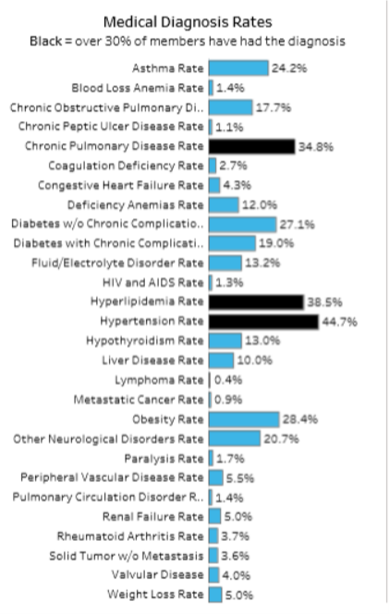
Tableau Reports: BHH Pop Health 2018
From July 2020
Health Promotion – using a curriculum/presentation to:
Educate clients, with or without the condition, on the consequences of having the medical diagnosis and measures they can take to prevent it
Offer opportunities for clients to share their barriers to managing their chronic condition and working with client to overcome those barrier

Slide 5
Ten Great Public Health Achievements in the United States
Based on US CDC calculations of impact on age adjusted mortality rates, the following areas of focus had the greatest impact on preventing disease and untimely death.
1900-1999 | 2000-2010
Vaccination Motor-vehicle safety Safer workplaces Control of infectious diseases Decline in deaths from coronary heart disease & stroke Safer and healthier foods Healthier mothers and babies Family planning Fluoridation of drinking water Recognition of tobacco use as a health hazard | Vaccine-preventable diseases Prevention and control of infectious diseases Tobacco control Maternal and infant health Motor vehicle safety Cardiovascular disease prevention Occupational safety Cancer prevention Childhood lead poisoning prevention Public Health preparedness and response

Slide 6
Public Health?
Public health works to protect and improve the health of communities through policy recommendations, health education and outreach, and research for disease detection and injury prevention (CDC)
Public health promotes and protects the health of people and the communities where they live, learn, work and play. (APHA)
Medicine and clinical treatment is not public health; public health incorporates medicine and clinical treatment
How do we treat a condition (clinical) vs how do we prevent or lessen the impact of a condition (public health).
Many times the line is blurred, but in each case the goal is the same – to make people healthier, improve quality of life and increase well-being

Slide 7
Clinical, Public Health or Combined?
Community wide effort to promote physical activity among those over age 65.
Screening program for diabetes among workers at manufacturing plant.
Use of BP medication to treat elevated BP
Mandated seat belt use
Monitoring BMI of clients
Monitoring BMI of clients and combining to get an average BMI for all clients
Using average BMI to assess the effectiveness of a physical activity program for clients

Slide 8
Behavioral Health and Public Health
Public Health and Behavioral Health
Smoking cessation
Physical activity
Harm Reduction
Recovery
Create supportive communities
Support and promote wellness and well-being
Focus on quality of life
Community education

Slide 9
Additional Background
Education only one part of public health and health promotion
Behavior change is key to protecting and promoting public health
Opportunity to change
Support
Policies
Laws and regulations
Example: tobacco use
Education
Support
Laws
Policies

Slide 10
Application
Health Promotion Activities
Needs Analysis
Plan Strategy
Implementation
Assess Impact
Modify Approach

Slide 11
Needs Analysis
What have you done or would you do to determine the health related needs of the population you are working with? Health area to work on?

Slide 12
Needs Analysis
Needs Analysis Information Sources
Diagnosis data
BHH Population Health Report
EHR Reports
Health behavior data
Survey Results
EHR Reports
Population interest data
Survey Results
Past Experience
Barriers

Slide 13
Plan Strategy
What are some of the strategies/activities that you have done or would like to do to promote positive health behaviors with your population?

Slide 14
Plan Strategy
Define Strategy
Choose one area of focus
Not necessarily diagnosis focus – behaviors that influence health
Healthy eating
Physical activity
Harm reduction
Overcome Barriers
Policy and procedure changes
Workforce
Group activities
Who needs to be involved
Opportunity to apply knowledge
Incremental changes

Slide 15
Plan Strategy
How will you measure success?
Benchmarks
Feedback loop
What will you do if things are not going as planned?

Slide 16
Implementation
What has been your experience with implementation? Lessons Learned? Strategies that make an impact?

Slide 17
Assess Impact
How have you assessed impact of interventions?

Slide 18
Assess Impact
How will you assess impact?
Behavior Change
Self report
EHR data
Diagnosis information
Clinical tests
Feedback from participants
Institutional/Structural Changes

Slide 19
Modify Approach
If implementing strategy again what would you do differently?
Target group
Too broad?
Too Narrow?
Activities
What would you modify?
Benchmarks?
Incorporate feedback from participants

Slide 20
Case Study
Needs Analysis
76 percent of your population smoke
64 percent of your population have hypertension
35 percent of your population haven’t had a teeth cleaning in the past 2 years
90 percent of you population report that they engage in little physical activity – 45 percent report a desire to increase physical activity
43 percent of your population over age 45 have not been screened for diabetes in the last 3 years according to your EHR
What would you pick and why? Would you like additional information?

Slide 21
Case Study
Plan Strategy
Activities directly with population
New policies or procedures
Workforce interventions
Structural Changes
What would you implement and why?
What are some possible benchmarks or measures to assess impact?

Slide 22
Case Study
Implementation
What possible roadblocks or issues might impact implementation? How would you continuously monitor to quality?

Slide 23
Case Study
Assess Impact
How would you assess impact?
Modify Approach
What are some of the possible ways to modify approach?

Slide 24
Additional Information
Office of Disease Prevention and Health Promotion https://health.gov/

