Slide 1
BHH September 2020 Workgroup:
Client Outreach & Engagement and Service Delivery during the COVID-19 Pandemic
September 18, 2020
Notes:
How to change Photos in this PPT:
Select photo
Right click > Format Picture
Select Fill > Picture or Texture fill
Select replacement photo from desired destination
To resize: Select Format Picture > Crop > Fill . Then you can position and resize the source photo as needed using white anchor points around the gray box.

Slide 2
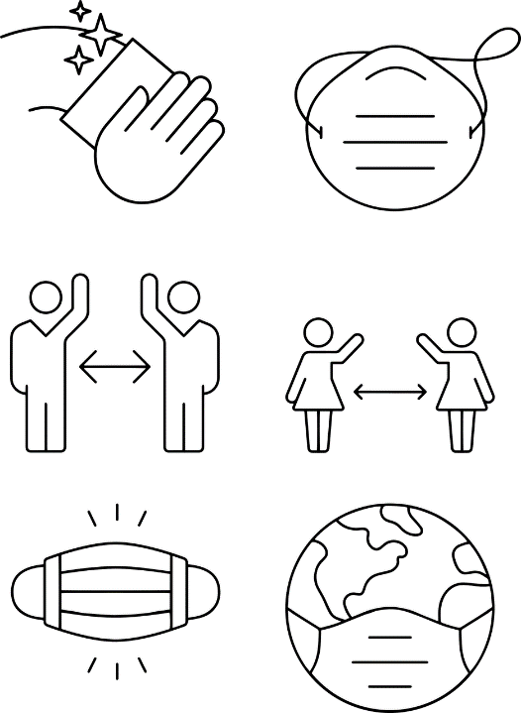
Part 1—
Using BHH Data to Understand the Impact of the Pandemic
Notes:
How to change Photos in this PPT:
Select photo
Right click > Format Picture
Select Fill > Picture or Texture fill
Select replacement photo from desired destination
To resize: Select Format Picture > Crop > Fill . Then you can position and resize the source photo as needed using white anchor points around the gray box.

Slide 3
How can we use data to examine the impact of the COVID-19 pandemic on service delivery?

Slide 4
DMHAS Billing Reports & Internal EHRs
BHH Client Summary Report
Compare # of services
03/01/2019-08/31/2019 VS 03/01/2020-08/31/2020
Identify changes in type of service offered
Is CM, TCM, or Psycho-ed the primary service during the pandemic?
Review clients that have not received any services since 03/13/2020
Was the client historically receiving services?
Client Records
Conduct a random chart review
Are select clients receiving services?
What type of services?
Are they receiving all 6 of the BHH core services?
Comprehensive Care Coordination
Care Management
Health Promotion
Patient & Family Support
Comprehensive Transitional Care
Referral to Community Support Services

Slide 5
What are some factors to considers when identifying clients at risk of disengagement?

Slide 6
At-risk Factors for Disengagement include:
stress or trauma caused by the pandemic
Client shows signs that may not be able to process isolation, the virus, etc.
A history of anxiety/fear of being alone/fear of germs
Unstable housing
Limited or no access to technology
Phone
Email
Ability to video conference
A substance abuse disorder diagnosis
Notes:
How to change Photos in this PPT:
Select photo
Right click > Format Picture
Select Fill > Picture or Texture fill
Select replacement photo from desired destination
To resize: Select Format Picture > Crop > Fill . Then you can position and resize the source photo as needed using white anchor points around the gray box.

Slide 7
How can you use the Tableau dashboards to identify clients who might be at risk of severe complications if exposed to COVID-19?

Slide 8
Some Tableau Dashboard Data points that may indicate a higher risk client include:
Health Assessment Status Dashboard
BMI: Morbidly Obese
Blood Pressure: SBP>140; DBP>120
Tobacco Assessment: Cessation offered/not offered
Depression screen: Current functional capacity may affect results
Periodic Assessment Dashboard
Living Situation: Homeless Shelter, Homeless
Employment Status: Unemployed
Lapse in Medicaid Report
Client who have not had Medicaid for an extended period of time and do not have an alternative insurance
CHN Gaps in Care Reports (All Non-Dual Clients)
Are they on the diabetes report?
Are they on the Medicaid that might affect their A1c report?
Are they way overdue for a Preventative or Wellness visit with PCP?
Are they on the Asthma Medication Compliance report?
Enrollee Level Dashboard
Useful to see if a client has multiple “risk” factors.
Example: A client who is diabetic, morbidly obese with high blood pressure and smokes might be of higher risk than a client who only smokes.

Slide 9
How can we use our relationships with community providers to identify clients at risk of severe complications if exposed to COVID-19?

Slide 10
Care Coordination and Referral to Community Support Services
ROIs for all community providers
Identify community providers/support that may be essential during this time
Ex. Homelessness prevention organizations and shelters
Consistent/ongoing conversations with providers that serve a your clients
Advocate for onsite care when appropriate
Develop a full list of clients’ health conditions
Provide them with information on your clients’ mental health

Slide 11
What are some examples of unique service delivery practices that can be used to increase engagement for at-risk populations?

Slide 12
New Approaches to Service Delivery
Bring clients onsite for telehealth session in a private office
Shift to direct assistance with basic needs
Case management services
Does the client have food?
Can the client make it to appointments?
Does the client have shelter?
Designate staff to be members of an outreach team
Meet outside of client’s home
Able to physically see how clients are doing
Elect Administrative staff to make welfare calls and learning sessions
Check in on the clients for the sake of checking in
Remind clients of COVID-19 safety protocols
Does the client have questions about appointments? Billing? Transportation?
Designate peer specialist to focus on promoting self-efficacy and self-advocacy
Push clients towards becoming more independent to ensure their basic needs can be met with or without agency support
Identify virtual spiritual support groups, recreational activities, and other community supports
No need to reinvent the wheel
Fall under referral to community support services
Focus on providing education/training to natural supports
Create or promote existing warm lines
Kopelovich, S. L., Monroe-DeVita, M., Buck, B. E., Brenner, C., Moser, L., Jarskog, L. F., Harker, S., & Chwastiak, L. A. (2020). Community Mental Health Care Delivery During the COVID-19 Pandemic: Practical Strategies for Improving Care for People with Serious Mental Illness. Community mental health journal, 1–11. Advance online publication. https://doi.org/10.1007/s10597-020-00662-z

Slide 13
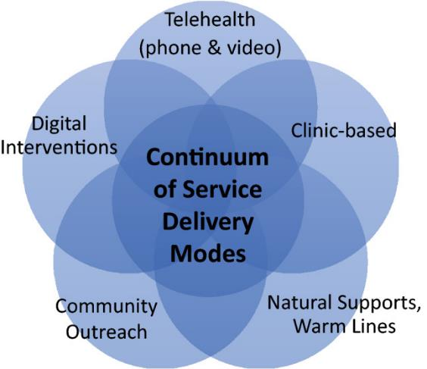
Continuum of service delivery modes for Community Mental Health Centers Clients Graphic was created by the National Center for Biotechnology Information: Nature Public Health Emergency Collection
https://www.ncbi.nlm.nih.gov/pmc/articles/PMC7304659/figure/Fig1/

Slide 14
Technology Literacy & Access
During this time, we need to work with our clients to:
Try to fill the gap between needed technology and the client’s access to technology
Access to phone
Set up emails
Help clients maintain minutes
Providing education on how to use technology
How to log onto Zoom
How to view electronic health records
How to set up appointments online

