Slide 1


The Person-Centered Recovery Plan as a Foundation for Quality in Healthcare
Janis Tondora
Person-Centered Recovery Planning Overview
November 20, 2020

Slide 2

Person-Centered Care...
A Fuzzy Concept?
  Consumers demand it, public service systems endorse it, medical and professional programs are encouraged to teach it, and researchers investigate it. Yet, people struggle to understand exactly what “It” is and what “It” might look like in practice.
    Tondora et al., 2005, Implementation of Person-Centered Care and Planning: How Philosophy Can Inform Practice
  PCRP represents a unique opportunity to move from person-centered THEORY to person-centered PRACTICE
Notes:
This is a layout for text plus picture. You do not want text or pictures that belong inside the box to exceed the box size. That means you may have to adjust the size of the box or the font size (nothing lower than 12 points). Remember to add alt text to any icon or picture.
There are additional slide layouts available. Select “Layout” from the “Home” tab. (If “Layout” is grayed out, you will need to place your cursor in an open area outside the slide to activate it.)

Slide 3
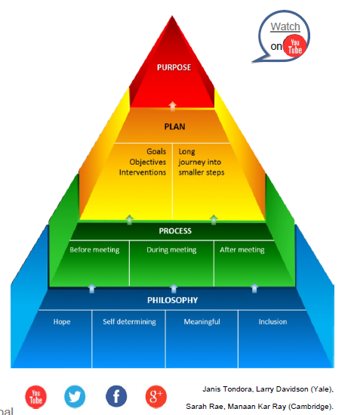
The 4 “Ps” of PCRP
Recently Released Web-based Video
& Tips Sheet Series
http://www.promise.global/propel.html
Tondora & Davidson (YALE) and
Rae, & Kar Ray (CAMBRIDGE)
The practice of PCRP can only grow out of a culture that fully appreciates recovery, self-determination, and community inclusion.
Can change what people “do”… but also need to change the way people feel and think.
*4 Essential Ps:
  Philosophy – core values
  Process – new ways of partnering
  Plan – concrete roadmap
  Purpose – meaningful outcomes
Notes:
This is a layout for text plus picture. You do not want text or pictures that belong inside the box to exceed the box size. That means you may have to adjust the size of the box or the font size (nothing lower than 12 points). Remember to add alt text to any icon or picture.
There are additional slide layouts available. Select “Layout” from the “Home” tab. (If “Layout” is grayed out, you will need to place your cursor in an open area outside the slide to activate it.)

Slide 4
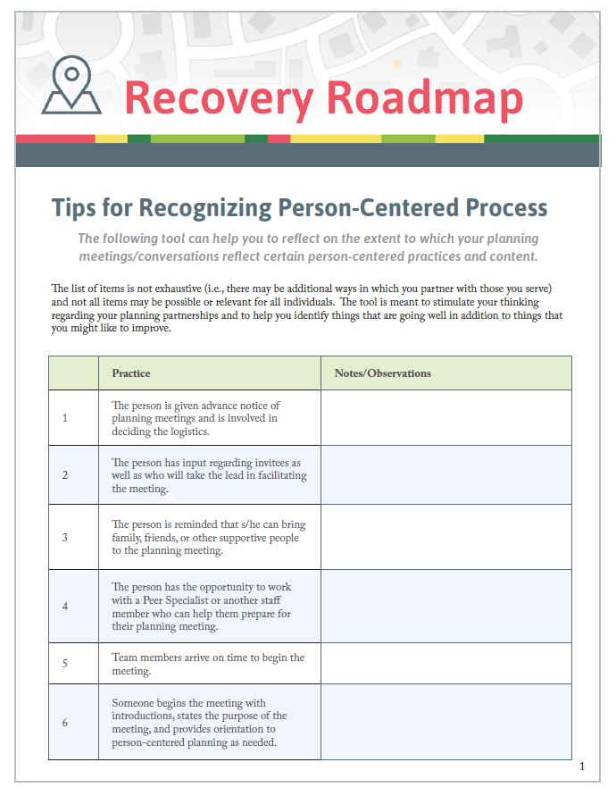
Warm Up Exercise: PCRP Process
Take a few minutes and review Tips for Recognizing Person-Centered Process
Items often refer to the “team” or team meeting but just as readily apply to 1:1 planning activities
Lets have each person identify at least ONE PCRP practice you already feel really good about, a personal strength in your collaborative planning. Practice what we preach and start with our strengths ☺
How about ONE thing you’d like to work on?
Let us know in the chat box…be sure to say if it’s a strength or a challenge…

Slide 5

Don’t we already do it?
Not necessarily… Meet Mr. Gonzalez
Mr. Gonzalez, a 31-year-old married Puerto Rican man, is living with bipolar disorder and he struggles with addiction to alcohol which he often relies on to manage distressing symptoms. During a recent period of acute mania, Mr. Gonzalez was having increasingly volatile arguments with his wife in the presence of his two young sons, ages 3 and 5. On one occasion, he shoved his wife to the floor which prompted her call to the police. When the police arrived at the home, Mr. Gonzalez was uncooperative and agitated, and he was subsequently admitted to an inpatient psychiatric facility for evaluation and treatment. His wife is open to reconciliation, and she is actively involved in his treatment at the hospital. Mr. Gonzalez states that his love for his family and his faith in God are what keep him going in difficult times.

Slide 6
Snapshot: A Traditional Plan
Goal(s):
Achieve and maintain clinical stability; reduce assaultive behavior; comply with medications
Objective(s):
Pt will attend all scheduled groups on unit and mall; Pt will take all meds as prescribed; Pt will complete anger management program; Pt will demonstrate increased insight re: clinical symptoms; Pt will recognize role of substances in exacerbating aggressive behavior
Services(s):
Psychiatrist will provide medication management; Social Worker will provide anger management groups; Nursing staff will monitor medication compliance

Slide 7
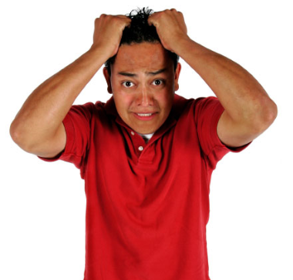
Traditional Plan
I’m here to return YOUR goals.
You left them on MY recovery plan!
Take my lithium
Increase insight
Reduce assaults
Comply with group schedule

Slide 8
POLL: So what do you think?
Which of the below is the best goal statement for Mr. Gonzalez’s PCRP and why?
I don’t want to lose control anymore.
Mr. Gonzalez will better manage distressing symptoms without drinking.
I want my family back.
Mr. Gonzalez will attend the anger management group.
I just want to be a good man.

Slide 9
Life Goal:
I want to get my family back.
I want to be a good role model for my boys.
Strengths to Draw Upon:
Devoted father; motivated for change; supportive wife; Catholic faith and prayer are source of strength/comfort; positive connection to Peer Specialist; intelligent
Barriers Which Interfere:
Acute symptoms of mania led to violence in the home; lack of coping strategies to manage distress from symptoms; abuse of alcohol escalates behavioral problems
Notes:
This is a layout for text plus picture. You do not want text or pictures that belong inside the box to exceed the box size. That means you may have to adjust the size of the box or the font size (nothing lower than 12 points). Remember to add alt text to any icon or picture.
There are additional slide layouts available. Select “Layout” from the “Home” tab. (If “Layout” is grayed out, you will need to place your cursor in an open area outside the slide to activate it.)

Slide 10
Sample Short-Term Objective(s)
Within 30 days, Mr. Gonzalez will apply learned coping strategies to have *positive interactions with wife and children during one supervised visit in family therapy session.
Services & Other Action Steps
Doc to provide med management daily for 2 weeks to reduce irritability & acute manic sx
Family Specialist to provide family therapy sessions 2X weekly to coach Mr. Gonzalez to provide psycho-education to family regarding mental health and recovery
CSP Specialist to provide weekly coping and communication Skills-Training to improve Mr. Gonzalez’s ability to manage distressing symptoms and to have healthy relationships at home (use of teaching, role playing, coaching, etc.)
Referral to spiritual counseling agency chaplain to promote use of faith/daily prayer as positive coping strategy to manage distress
Wellness Recovery Action Plan with Peer Specialist to promote illness self-management
Notes:
This is a layout for text plus picture. You do not want text or pictures that belong inside the box to exceed the box size. That means you may have to adjust the size of the box or the font size (nothing lower than 12 points). Remember to add alt text to any icon or picture.
There are additional slide layouts available. Select “Layout” from the “Home” tab. (If “Layout” is grayed out, you will need to place your cursor in an open area outside the slide to activate it.)

Slide 11
PCRP Honors Both Professional Expertise and the Wisdom of Lived Experience
Important TO the Person
Important FOR the Person
Meaningful relationships
A place of my own
Valued social roles
Independence
Freedom to Make Choices
Cultural and personal preferences
Faith and spirituality
A job, a career
Basic health and safety
Management of clinical symptoms
Maslow’s basic needs
Harm reduction
Management of risk
Legal obligations and mandates
Notes:
This is a layout for text plus picture. You do not want text or pictures that belong inside the box to exceed the box size. That means you may have to adjust the size of the box or the font size (nothing lower than 12 points). Remember to add alt text to any icon or picture.
There are additional slide layouts available. Select “Layout” from the “Home” tab. (If “Layout” is grayed out, you will need to place your cursor in an open area outside the slide to activate it.)

Slide 12
Moving from the
PROCESS of PCRP to the
DOCUMENTATION of PCRP?
Can you co-create a plan that honors the person and still satisfies the chart?
12
Notes:
12

Slide 13

…and in a way that balances the spirit of person-centered care with the rigor required in plan documentation?
Regulations
Required Paperwork
Medical Necessity
Compliance
Collaborative
Person-Centered
Strengths-based
Transparent

Slide 14
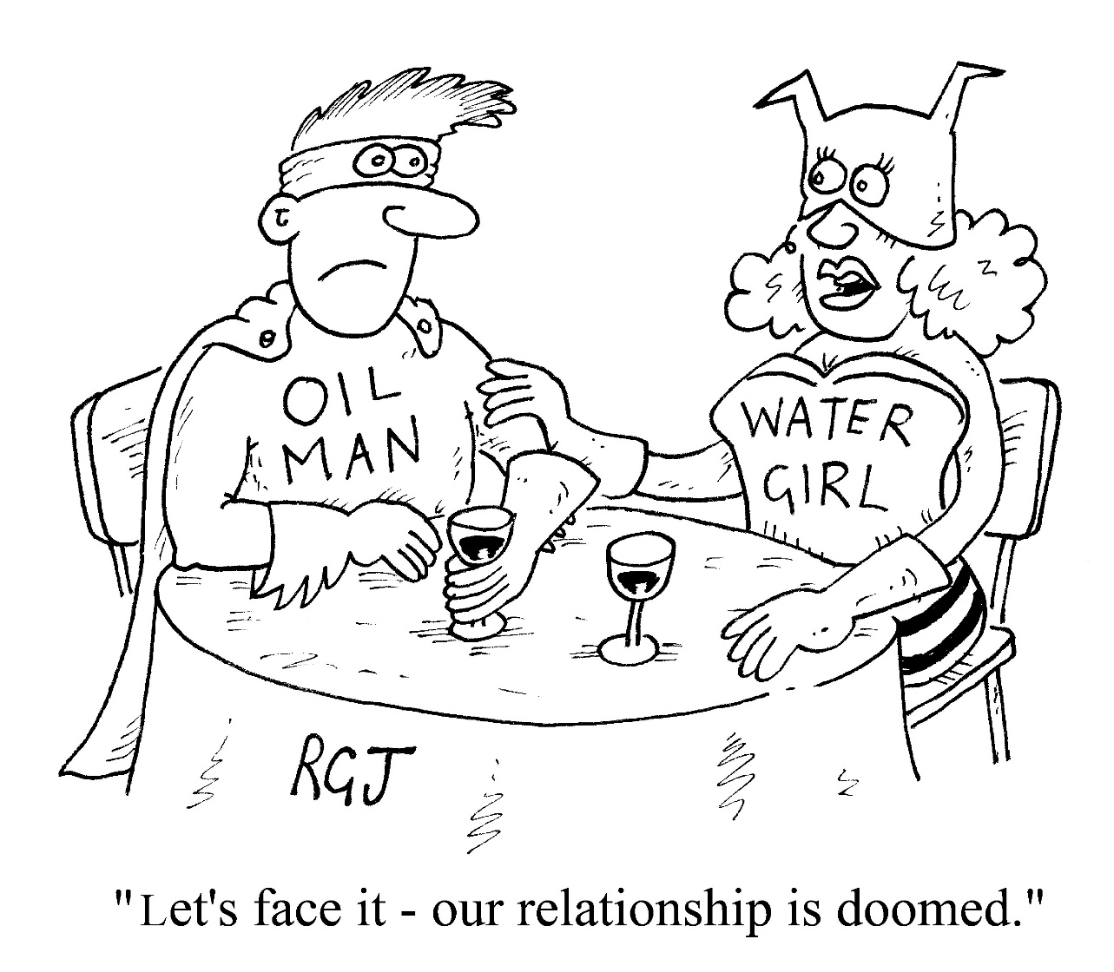
Irreconcilable differences, happily ever after… (or at least a peaceful co-existence?)
Regulatory-focused
Clinical/Professional Expertise
Person-Centered
Lived Experience
“Let’s face it – our relationship is doomed!”

Slide 15

Person-Centered Plans are Grounded in Person-Centered Assessment
Assessment is enhanced around commonly neglected areas:
  strengths/interests
  cultural preferences and treatment implications
  stage of change/readiness
  AND concludes with an integrated summary/formulation that goes beyond the data!

Slide 16

Integrated Summary: Moving From the “WHAT” to the “WHY”
Moves from the “what” (facts only) to the “why” (i.e., how you make sense of the data.)
  “Hypothesis” or best-guess as to what is going on
  Informed by both the person’s understanding as well as by your professional opinion
  Information in summary should have a direct impact on the plan
  Recorded in a chart narrative – in the “integrated summary”
  “shared” with person served
A well-written integrated summary is the BRIDGE between the data/assessment and the plan!

Slide 17
An Example: WHY do individuals choose not to use meds at times?
Person is concerned about side-effects
Exploration of medications with different side effect profiles, consultation with nutritionist to get support to off-set weight gain, family-based interventions to help couples deal with sexual side-effects
Person has a culturally-informed preference to use alternative healing strategies
Collaboration with faith-based or cultural healers, integration of alternative strategies into recovery plan
Person becomes disorganized and struggles with keeping track of complex medication schedule
Cognitive remediation, skills training, compensatory strategies to promote organization

Slide 18

How Should Assessment Data Feed into the Plan?
Problem-Centered
One Goal for Every Problem as Identified in the Assessment
Person and Goal-Centered
Goal of the PERSON and
How Barriers Interfere
Problem: Assaultive behavior
  Goal: Assault free x 1 month
Problem: Poor hygiene/self-care
  Goal: Shower/bathe regularly
Problem: Substance use
  Goal: Abstain from alcohol x 2 weeks
Problem: Auditory Hallucinations
  Goal: Increase reality testing
I want my job back so I can provide for my kids.
    Impulse control issues led to physical conflict with co-worker and termination.
    Self-care improvements needed to present well in job interviews.
    Substance use led to frequent absenteeism and job loss
    Auditory hallucinations make it difficult to interact with customers at retail job.
This Photo by Unknown Author is licensed under CC BY-NC

Slide 19

Big Picture View PCRP Elements
GOAL
as defined by person;
what they are moving “toward”…not just eliminating
Strengths/Assets
to Draw Upon
Barriers/Assessed Needs
that Interfere
Short-Term Objective
S-M-A-R-T
Interventions/Methods/Action Steps
                Professional/“billable” services
                Clinical & rehabilitation
                Action steps by person in recovery
                Roles/actions by natural supporters

Slide 20
Goals: What Do People Want?
Independence
I want to control my own money.
Work /education
I want to finish school
Spiritual connection
I want to get back to church.
Health/well-being
I want to lose weight.
Housing
I want to move out of the group home.
Social activities
I want to join a bowling league.
Satisfying relationships
I want to see my grandkids.
Valued Roles
I want to volunteer at the Senior Center.
To be part of the life of the community…

Slide 21
And NOT just the territory of traditional treatment plans…
Goal:
  Maintain psychiatric stability
Objectives
  Compliance with meds
  Attend appointments with primary care provider
  Attend all psychiatric appointments as scheduled

Slide 22
Think about It…
(Chat Box Exercise/Reflection)
What we hope for THEM…
What we value for US…
Compliance with treatment
Decreased symptoms/Clinical stability
Better judgment
Increased Insight…Accepts illness
Follows team’s recommendations
Decreased hospitalization
Abstinent
Motivated
Increased functioning
Residential Stability
Healthy relationships/socialization
Use services regularly/engagement
Cognitive functioning
Realistic expectations
Attends the job program/clubhouse, etc.
Life worth living
A spiritual connection to God/others/self
A real job, financial independence
Being a good mom…dad…daughter
Friends
Fun
Nature
Music
Pets
A home to call my own
Love…intimacy…sex
Having hope for the future
Joy
Giving back…being needed
Learning
22

Slide 23

Think About It…
Just imagine…
Family
Friends
Job
Beyond US and THEM
  People with mental health and addictions issues generally want the exact same things in life as ALL people.
  People want to thrive, not just survive…

Slide 24

Challenges in Goal Setting
A person’s goals may change!
The language of goals and goal-setting can be intimidating!
    Go back to your strengths-based assessment: Visualize an “ideal day” - what would this look like? What would you be doing? Who would you be with? If you had a magic wand…
The process of goal development takes time and a trusting relationship
Not all people can easily articulate personal goals/desired results
  It’s OK to make a suggestion to get the ball rolling!
Not just the first words out of a person’s mouth
Goals often unfold through reflective listening

Slide 25
Goals
  Long term, valued life roles, activities, and relationships
  Life changes as a result of services
  Ideally expressed in person’s own words
  Written in positive terms
  Consistent with desire for self-determination
    Influenced by personal world view

Slide 26

Barriers
What is getting in the way of the person achieving their goal?
    Why can’t they do it tomorrow?
    What prevents them from doing it on their own?
  Consider:
    Need for skills development, intrusive symptoms, lack of resources, problems in behavior, difficulty in activities of daily living, disruptions in meaningful relationships and roles, threats to basic health and safety, challenges/needs as a result of a mental/alcohol and/or drug disorder; diagnosis alone is NOT the barrier
In order to inform and individualize the plan, it is important to be explicit and describe not just WHAT is getting in the way, but HOW…

Slide 27
Descriptive Barriers Connect the Dots Back to the Goal
Weak Examples
Strong Examples
Anger issues
Depressive symptoms
Addiction
Serious medical issues
Outbursts and conflicts with neighbors
Lacks the energy to take care of basic household tasks
Substance use has led to police calls and risk of eviction
Unstable blood sugars have led to medical emergencies and hospitalization

Slide 28

Strengths
Identifies aspects of the person’s life that they can draw from to move toward a specific goal
Promotes engagement and communicates message of hope and confidence in the person’s abilities
Captures the person’s unique identity, resources, interests
  best qualities/motivation
  strategies already utilized to help, self-directed wellness
  competencies/accomplishments
  cultural traditions and connections
  community and social relationships
  environmental factors that will increase the likelihood of success

Slide 29
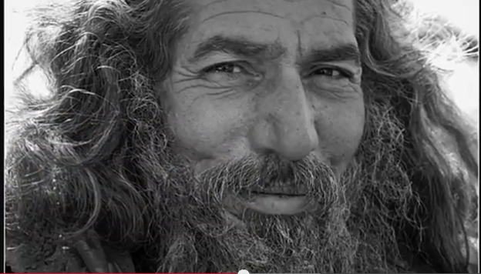
Strengths as the Foundation of the Plan
Video clip…The Gestalt Project
http://www.youtube.com/watch?v=QficvVNIxTI&feature=youtu.be

Slide 30

Questions for Consideration
After the video, we’ll move into Zoom breakouts for a few minutes to discuss:
What stood out for you in the clip and why?
How did you feel emotionally MID-WAY through the clip? How did you feel at the end?
What did you learn? And how might this relate to PCRP language and thinking? What if YOU were defined largely by ONE part of yourself – a part you really struggle with…maybe an illness, maybe a difficult experience in your life. What would that be like?
What types of stories do we craft about the people we serve and the lives they live? How can we use language to promote a more hopeful narrative?
And then reconvene to “compare notes”

Slide 31

Capitalize on Strengths in the Plan
i.e., A person with a love for books might be engaged by asking him/her to help out in the agency library…
A person who loves music might benefit from access to CDs/headphones as away to quiet voices…
A spiritual person contemplating suicide might want direction from a Spiritual Director…
An animal lover struggling with obesity due to med side effects might walk a dog regularly.
How about all of you? Any favorite stories out there of how you have tapped into strengths in your work with people n recovery? Let us know in the chat?

Slide 32
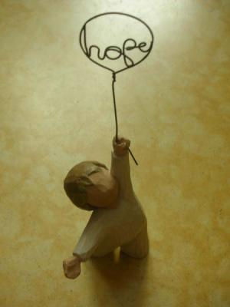
Short-term Objectives: What do they do?
Concrete, positive CHANGES in behavior/functioning/status
Divide larger goals into manageable steps of completion
“Proof” you are getting closer; help to assess progress; is all your LINKING working?
Send a hopeful message we believe things can, and will, be different for the better!

Slide 33

Objectives Should be SMART
Here’s a way to evaluate your objectives. Are they SMART?
  Simple or Specific
  Measurable
  Achievable
  Relevant
  Time-framed
  Will you definitively be able to say, it was achieved, yes or no…?

Slide 34
Technical Formula for Crafting Objectives
Within_______(amount of time), _________ (Name) will have improved (documented barrier) ____________, as evidenced by________ (a meaningful change in functioning or behavior that is related to the life role goal.)
Examples:
Within the next 30 days, John will have improved management of panic as evidenced by successfully riding the subway to work without exiting the train before his stop.
Phillip will have increased social interaction as evidenced by meeting a friend for coffee at Dunkin’ Donuts at least one time per week within the next 30 days.

Slide 35
Objectives Are About Outcomes, NOT Service Participation
  The following objective is about service participation:
  People can participate in services for years and not achieve the intended benefits!
  i.e., Wanda will voluntarily attend DBT group 2x weekly.
  Objectives are about what you hope will change for the person as a result of services & the person’s hard work:
  i.e., Wanda will apply mindfulness techniques to reduce instances of self-injury to no more than one per week for 2 consecutive weeks.
Notes:
will apply mindfulness techniques to reduce instances of self-injury to no more than one per week for 2 consecutive weeks.

Slide 36
Short-term Objectives –
Critical in Care Coordination
  Even though OTHER providers (even outside of your agency may be responsible for providing the DIRECT services, as the Care Coordinator, YOU are the one responsible for monitoring whether or not the whole package is WORKING (or not!)
  A well-written, short-term goal/objective is your opportunity to do this quality check
  Ask, as a result of all this linking and referring, what does the person hope will be different – in a concrete, meaningful way??

Slide 37

What brings people to care? How ready are they to make certain health changes? How can you meet them where they are at?
Do I need to make this change?
Can I do it?
Do I have supports?
Will my life be better?
Do I want help?
Notes:
This an interactive exercise adapted from PR

Slide 38
“Just Right Fit” Objectives
Continuum of Abilities and “Starting Places”
Too Easy
Too Hard
Current Functioning
Goal
Let’s assume Audrey wants to go back to work but currently, severe depression & sleep disturbance is making it difficult for her to get out of bed
Over the next 90 days, Audrey will be able to get out of bed by 9am at least 4 days out of 5 M-F as evidenced by report of shelter staff.

Slide 39
Stage Responsive Objectives:
From Learning to Doing
Client will reduce assaultive behavior.
  Within 90 days, Amy will identify 3 triggers to behavioral outbursts with children.
    (LEARNING objective)
  Within 90 days, Amy will have a minimum of one successful visit with her children AEB by report of Amy’s DCF Case Worker
    (BEHAVIORAL OBJECTIVE)

Slide 40

Interventions/Services & Action Steps
  The plan serves as a contract for who is responsible for what actions:
    Reflect a use of EBPs
    Respect individual choice and preference
    Describe medical necessity by clearly describing how services are intended to overcome that individual’s barriers
    Are specific to the individual’s objective, no “kitchen sink” service sets
40
Notes:
40

Slide 41

Critical Elements – The “Ws”
Professional services should specify…
  WHO will provide the service, i.e., name and job title
  WHAT: The TITLE of the service, e.g., Health & Wellness Group
  WHEN: The SCHEDULE of the service, i.e., the time and day(s)
  WHY: The individualized INTENT/PURPOSE of service
Notes:
41

Slide 42
Documentation of Care Coordination Interventions/Services
Think of Care Coordinators as the conductors of the orchestra… they may not be playing any of the instruments but they coordinate the “players”…
  i.e., MORE linking, monitoring, referring, observing, coordinating, etc., and LESS direct service/skill-building
In contrast, other direct practitioners you refer to/collaborate with are the direct “players” in the orchestra
  i.e., MORE direct service/skill-building to enhance the person’s performance and functioning, e.g., teaching, treating, coaching, practicing, role-playing, demonstrating/modeling of skills, etc.

Slide 43
Examples of Interventions/Services
Comprehensive Care Management (internal) to collaborate with treating Psychiatrist a minimum of 1x/month for the purpose of adjusting medications prn and monitoring symptoms, e.g., Mary's tendency to isolate and avoid social situations.
Care Coordination (external) with Primary Care Doctor and Dentist within the next 2 weeks to prepare for Luis’ upcoming dental surgery and ensure necessary pre-op bloodwork and health testing is completed.
Health Promotion coaching 1x/weekly for the next 3 months for the purpose of assisting Joe to self-monitor blood sugar levels and identify healthy meals for better managing his diabetes.
Patient and Family Support 2x in the next month to teach Bob to learn skills for using public transportation to be able to get to both medical and behavioral health appointments as well as the local YMCA for his exercise class.
Referral to Community Support Services within 2 weeks for the purpose of assisting Janine to access Vocational Rehabilitation services to support her goal of returning to work.

Slide 44
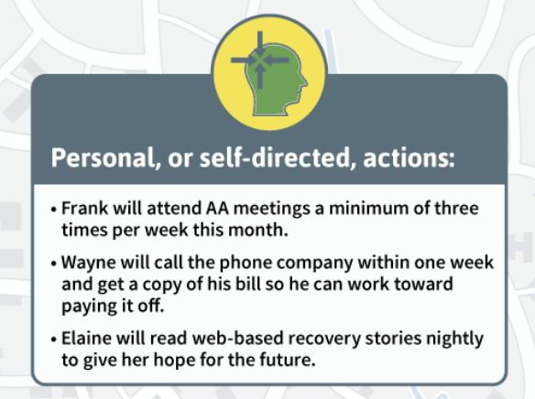
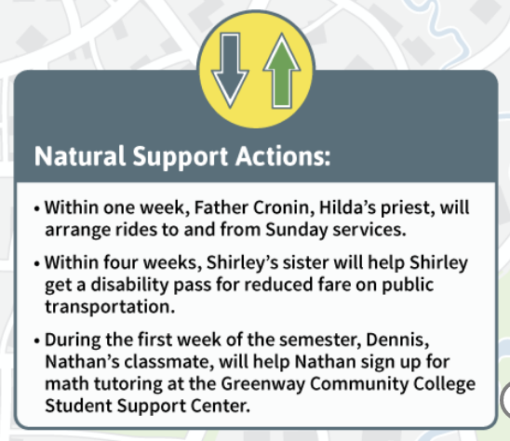
Interventions:
Self Directed and Natural Support Actions
Self-directed actions are a reminder that the consumer, too, has a responsibility in contributing to the recovery plan.
Natural Support actions reflect the growth of the informal recovery network that supports the person’s recovery over time.

Slide 45
Example #1: Harriet
Admitted for the 3rd time in the past year to Parks Hospital after coming to the ER for feeling weak, thirsty and light – headed.
Her blood sugar was 470. After previous discharges from Parks Hospital for Hyperglycemia, she has not followed up with the hospital’s recommendations to schedule a primary care visit to manage her HTN and diabetes. Believes the use of syringes is “dirty” and “unsanitary”.
Harriet is engaged in services with her CMHC and takes prescriptions for schizophrenia as prescribed.

Slide 46
Goal:
“I Want To Get Back to Work”
Strengths
Barriers
Actively engaged in mental health treatment to manage her schizophrenia
Actively willing to take medications for her diagnosis of schizophrenia with support of peers
Has several friends that she socializes with that have diabetes
Looking forward to having a home health care Coordinator
Is interested in the money she can save by not smoking
Looks forward to returning to work
Overweight
Has had multiple primary care providers
Doesn’t feel different when taking HTN medications and therefore does not get prescriptions filled regularly
Co-workers smoke cigarettes
Beliefs that using syringes to manage her diabetes is “unclean” and “dirty”
Three recent hospitalizations related to HTN and diabetes

Slide 47
Barriers, Objectives and Services
Barrier | Objective/Step | Interventions
Harriet wants to sustain smoking cessation in order to improve her health/continue to work however has co-workers that smoke. | Over the next three months, Harriet will show improved physical health as evidenced by remaining smoke free. | Comp Care Management Services 1x/monthly with CMHC therapist who provides smoking cessation group to problem solve barriers faced with smoking cessation at work. Comp Care Management Services with CMHC psychiatrist over the next three months to monitor impact of smoking cessation medications. Frank, Harriet’s co-worker, will go walking with Harriet during work breaks to help her reduce smoking in order to achieve improved health and remain working as a mechanic.
Harriet does not feel that the medications for HTN make her feel any different. | Harriet will improve management of her hypertension as evidenced by taking medications daily over the next 3 months. (with 6 month update to address HT levels). | Care Coordination with Harriet and her primary care physician three times a month over the next three months to monitor engagement and outcomes of her physical health. Health promotion once a week over the next three months by Nurse to provide education, monitor blood pressure and support Harriet’s interest in taking medication as prescribed so she can stay out of the hospital.
Harriet has beliefs that using syringes to manage her diabetes is “unclean” and “dirty. | Harriet will challenge her beliefs related to syringes as evidenced by giving herself daily insulin injections for a period of 2 months during the next 3 months. (with 6 month update to address BSL) | Direct patient Support by Peer Support worker, who also has diabetes, will accompany Harriet to weekly diabetes management group in the community to learn about using syringes and managing diabetes. Direct patient Support by Nurse to visit Harriet, at her home, once a week over the next three months to provide education, monitor diabetes, and assist Harriet in challenging her beliefs related to syringe use in order to avoid unnecessary hospitalization.

Slide 48
Your Turn to Practice: Meet Gerry
Gerry lives with a diagnosis of disorganized schizophrenia and has spent years off/on in the state hospital. He is currently living in a 24-7 monitored residential group home. Gerry reports he is very lonely. He used to go to the downtown jazz fests and meet lots of people, but now he feels like a “zombie.” He is not getting out of the house to do much of anything other than come to the Center. He wonders if this is due to his meds or his severe sleep apnea (he’s only getting a few hours of sleep a night) or something else… Although he would like a girlfriend, Gerry admits to being “terrified” to get out in community and meet women, and states that its been 10 years since he dated anyone. He wouldn’t know where to start…He is currently unable to take the bus and is afraid to go anywhere alone because he often gets confused or fears others might try to hurt him.
48
Notes:
48

Slide 49
POLL: So what do you think?
Which of the below is the best goal statement for Gerry’s PCRP?
I don’t want to feel like a “zombie.”
Gerry will better manage distressing symptoms of paranoia.
I want a girlfriend.
Gerry will attend the Sleep Apnea Hygiene Group.
I just want to be happy.

Slide 50
POLL: So what do you think?
Which would be the best meaningful SMART objective for Gerry’s PCRP?
Assume Gerry’s valued goal is
“I want a girlfriend…someone to share my life with.”
Case manager will refer Gerry to the local Adult Recreation Department within 1 week.
Gerry will participate in at least one social activity per week outside the group home for the next 90 - days.
Gerry will have less distress due to paranoia.
Gerry will attend the Social Skills Group weekly.
Gerry will pay his cable bill on time each month for the next 3 months.

Slide 51
Gerry’s PCRP
Goal: I want a girlfriend…someone to share my life with.
Strengths:
  Motivated to reduce social isolation; supportive brother; has identified community interests he enjoyed in past (e.g., music, Chinese restaurants) well-liked by peers; humorous
Barriers/Assessed Needs/Problems:
  Intrusive thoughts; can feel threatened by others in social situations; possible negative symptoms of schizophrenia and/or med side effects and/or sleep apnea result in severe fatigue/inability to initiate (social isolation, lethargy); easily confused/disorganized; need for skill development to: use public transportation/increase community mobility, develop symptoms management/coping strategies, challenges in communication and social skills, difficulty with self care routine
Objective:
  Gerry’s comfort around others will improve as evidenced by his participation in a minimum of 1 preferred social activity (outside the group home) per week for the next 90 days

Slide 52
Interventions/Services & Action Steps
Comprehensive Care Management with Clinician who provides CBT to increase Gerry’s ability to cope with distressing symptoms in social situations (teaching thought stopping, distraction techniques, deep-breathing, visualization, etc.)
Care Coordination with community psychiatrist who provides Med Management to monitor therapeutic impact and possible side effects to reduce fatigue and optimize functioning
Health Promotion services 2x over the next month to assist Gerry with fitting and nightly positioning of his sleep apnea mask to address sleep disturbance which contributes to fatigue.
Patient and Family Support with Peer Coordinator who will provide travel training 1X/wk. for 4 weeks to help him become independent with city bus (e.g., identifying most direct bus routes, rehearsing use of coping skills, role playing conversations if confused/lost, etc.)
Gerry’s brother, Jim, will accompany Gerry to weekly social outings over the next 3 mos.
Gerry will complete a daily medication side-effect log for the next 2 months while meds are evaluated and adjusted.
52
Notes:
52

Slide 53

Closing Q & A… Your Thoughts and Ideas
For more information:
janis.tondora@yale.edu
wartdan@optonline.net
Notes:
This is a layout for text plus picture. You do not want text or pictures that belong inside the box to exceed the box size. That means you may have to adjust the size of the box or the font size (nothing lower than 12 points). Remember to add alt text to any icon or picture.
There are additional slide layouts available. Select “Layout” from the “Home” tab. (If “Layout” is grayed out, you will need to place your cursor in an open area outside the slide to activate it.)

Slide 54
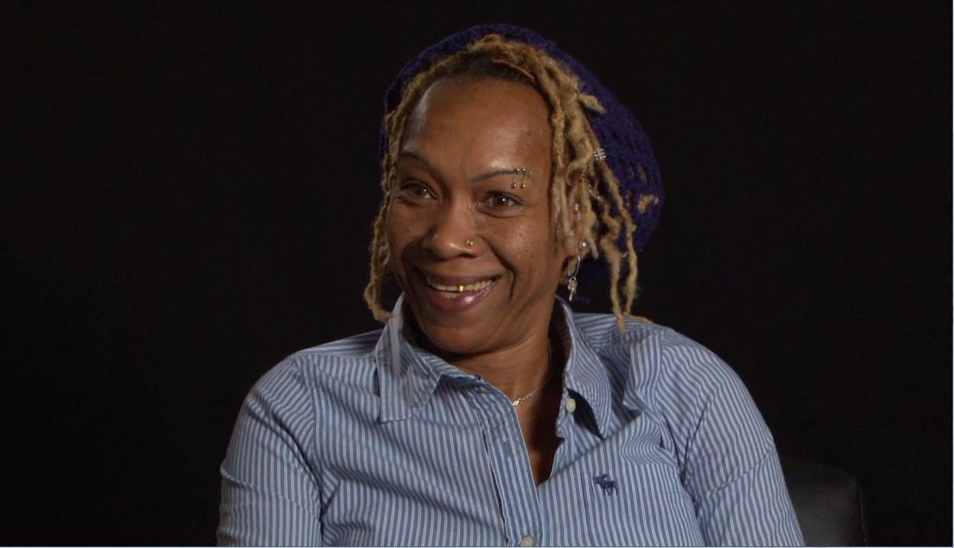
Summary Video: “I’m on the team!”
Your Efforts Do Not Go Unnoticed…
Notes:
BEFORE/AFTER Video
3:00

Slide 55
Take home message…
  You CAN create a recovery plan which honors the person and satisfies the chart!
  This is central in your partnership with individuals so they can move forward in their recovery in the community of their choice!
  We just need to stop accepting what is and start creating what should be…
  Dale DiLeo

