Slide 1
BHH Designated Provider Agency Work Group
February 2021
Notes:
How to change Photos in this PPT:
Select photo
Right click > Format Picture
Select Fill > Picture or Texture fill
Select replacement photo from desired destination
To resize: Select Format Picture > Crop > Fill . Then you can position and resize the source photo as needed using white anchor points around the gray box.

Slide 2
Agenda
1 | Billing Updates
2 | 2020 BHH Consumer Satisfaction Survey
3 | 2020 BHH Health Assessments
Notes:
The text in this slide is in a table. To make changes: simply add/delete rows as necessary.
Do not delete any columns.

Slide 3
Billing Updates
DMHAS Billing BHH Services
Audio & Visual Billable Codes – Provider Questions
February 2021
Notes:
How to change Photos in this PPT:
Select photo
Right click > Format Picture
Select Fill > Picture or Texture fill
Select replacement photo from desired destination
To resize: Select Format Picture > Crop > Fill . Then you can position and resize the source photo as needed using white anchor points around the gray box.

Slide 4
BHH Consumer Satisfaction Survey
2020 Survey Results
2021 Consumer Survey – Provider Questions
February 2021
Notes:
How to change Photos in this PPT:
Select photo
Right click > Format Picture
Select Fill > Picture or Texture fill
Select replacement photo from desired destination
To resize: Select Format Picture > Crop > Fill . Then you can position and resize the source photo as needed using white anchor points around the gray box.

Slide 5
2020 Health Assessments
Deadline to Enter Data
Statewide Rates
Agency-Specific Interventions

Slide 6
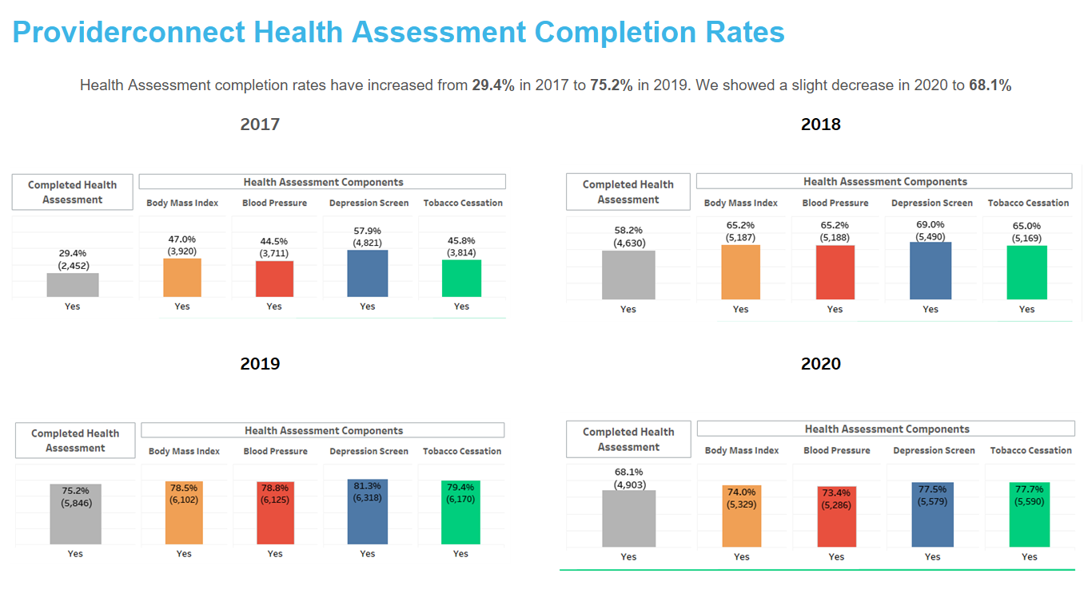

Slide 7
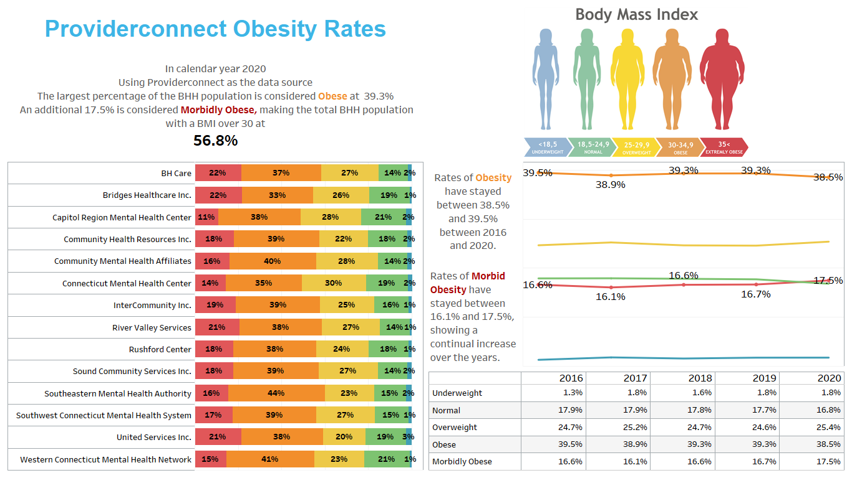

Slide 8
2019 BHH Population Profile on Obesity
In 2019 Population Profile 29.8% (N=2,346) members were diagnosed with Obesity. White Non-Hispanic females between 45 and 54 years of age had the highest rates.

Slide 9
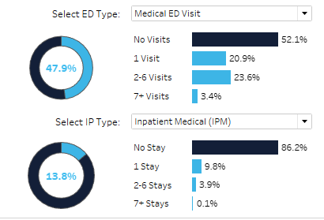
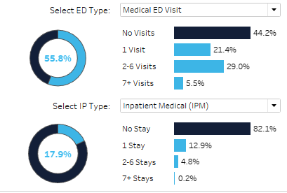
Obesity and High Levels of Care (ED and Inpatient) Without Obesity DX With Obesity DX Average Spend $34,107.00 $38,399.00

Slide 10
Obesity and Other Medical Conditions Without Obesity DX With Obesity DX
Hypertension Rates 45.1%
Hyperlipidemia Rates 38.8%
Diabetes w/o Complications 26.7%
Diabetes with Complications 19.1%
Asthma Rates 22.7%
COPD Rates 15,4%
Hypertension Rates 58.9%
Hyperlipidemia Rates 50.8%
Diabetes w/o Complications 37.7%
Diabetes with Complications 29.8%
Asthma Rates 31.7%
COPD Rates 17.5%

Slide 11
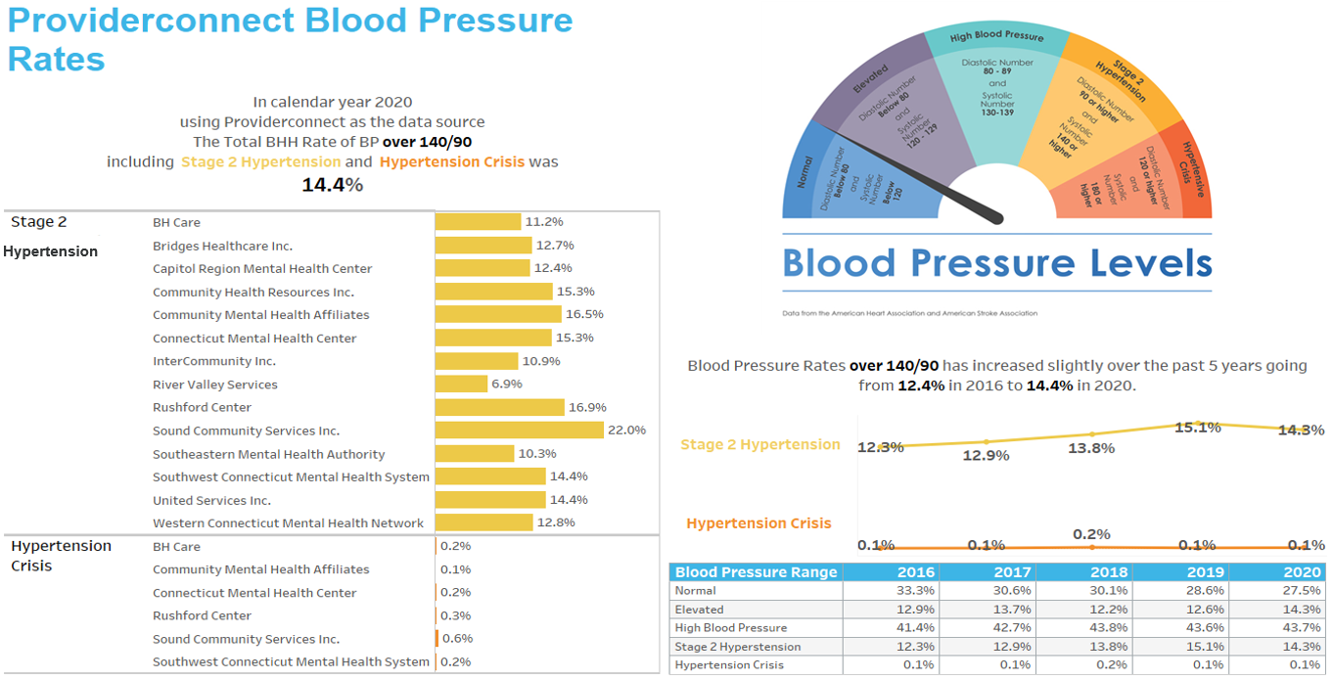

Slide 12
2019 BHH Population Profile on Hypertension
In 2019 Population Profile 45.1% (N=3,553) members were diagnosed with Hypertension. White Non-Hispanic females between 55 and 64 years of age had the highest rates.

Slide 13
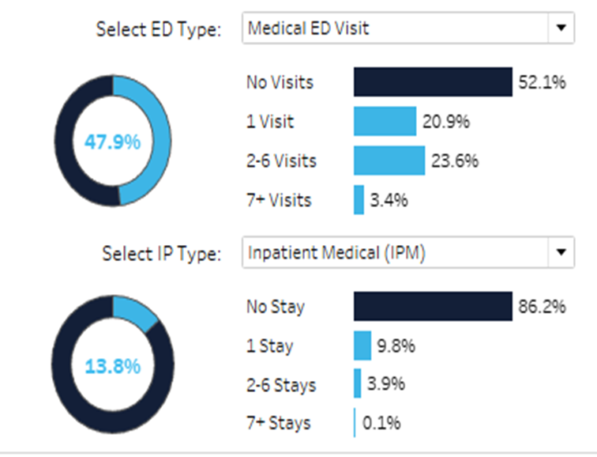
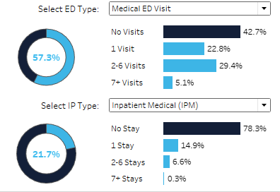
Hypertension and Medical ED and Inpatient Stays Without Hypertension DX With Hypertension DX $34,107.00 $40,745.00

Slide 14
Hypertension and Other Medical Conditions Without Hypertension Dx With Hypertension Dx
Obesity Rates 29.8%
Hyperlipidemia Rates 38.8%
Diabetes w/o Complications 26.7%
Diabetes with Complications 19.1%
Asthma Rates 22.7%
COPD Rates 15.4%
Obesity 38.9%
Hyperlipidemia Rates 57.6%
Diabetes w/o Complications 45.6%
Diabetes with Complications 35.2%
Asthma Rates 25.9%
COPD Rates 23.4%

Slide 15
Contact Us
1-844-551-2736
www.ctintegratedcare.com

